Slide 1
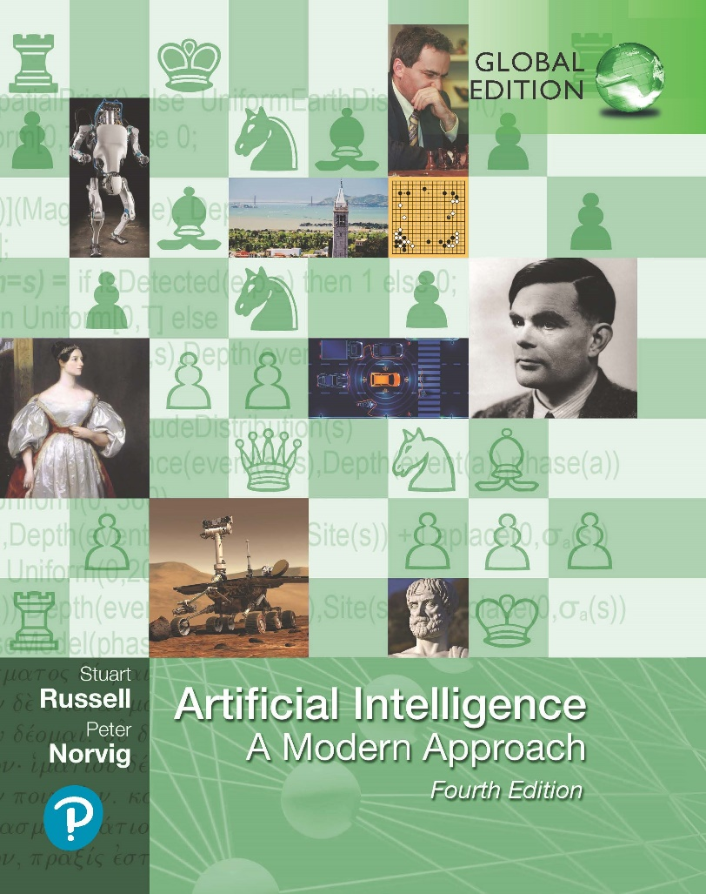
Artificial Intelligence: A Modern Approach
Fourth Edition, Global Edition
Chapter 17
Multiagent Decision Making
© 2022 Pearson Education Ltd.

Slide 2
Outline
Properties of Multiagent Environments
Non-Cooperative Game Theory
Cooperative Game Theory
Making Collective Decisions
© 2022 Pearson Education Ltd.

Slide 3
Properties of Multiagent Environments
One decision maker
multiple actors, it contains only one decision maker.
benevolent agent assumption: agents will simply do what they are told
Special case: a single decision maker with multiple effectors that can operate concurrently
Multieffector planning manages each effector while handling positive and negative interactions among the effectors.
Multibody planning: effectors are physically decoupled into detached units

Slide 4
Properties of Multiagent Environments
Multiple decision maker
multiple actors, multiple decision makers.
each have preferences and choose and execute their own plan
There are two possibilities:
Common goal for the actors, coordination problem (same direction)
Own personal preference and can be diametrically opposed
Game theory: theory of strategic decision making.
players each taking into account how other players may act
Used in agent design and mechanism design
It can be a cooperative game where a binding agreement between agents exists enabling robust cooperation.
non-cooperative game: no central agreement and no guarantee of cooperation

Slide 5
Properties of Multiagent Environments
Multiagent planning
Issue of concurrency: plans of each agent may be executed simultaneously
Agents must take into account the way in which their own actions interact with the actions of other agents.
Interleaved execution approach:
certain the order of actions in the respective plans will be preserved
assume that actions are atomic
must be correct with respect to all possible interleavings of the plans
does not model the case where two actions actually happen at the same time.
the number of interleaved sequences is exponential with the number of agents and actions rising

Slide 6
Properties of Multiagent Environments
True concurrency approach:
do not attempt to create a full serialized ordering of the actions,
partially ordered
Perfect synchronization approach
Global clock,
Same time, same duration, actions are simultaneous.
simple semantics
Concurrent action constraint: actions must or must not be executed concurrently

Slide 7
Properties of Multiagent Environments
Planning with multiple agents: Cooperation and coordination
Adopt convention before engaging in joint activity
Convention: constraint on the selection of joint plans
When conventions are widespread, they are called social laws
Agents can use communication to achieve common knowledge of a feasible joint plan.
Plan recognition: single action (or short sequence of actions) by one agent is enough for the other to determine a joint plan unambiguously

Slide 8
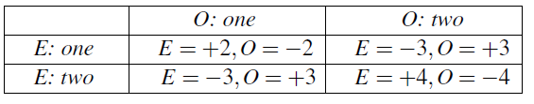
Non-Cooperative Game Theory
Games with a single move: Normal form games
All players take action simultaneously
No player has knowledge of the other players’ choices
Defined by 3 components
Players
Actions
Payoff function: utility to each player for each combination of actions by all the players (payoff matrix)
Two-finger Morra game, two players, O and E, simultaneously display one or two fingers. Let the total number of fingers displayed be f . If f is odd, O collects f dollars from E; and if f is even, E collects f dollars from O.¹ The payoff matrix for two-finger Morra is as follows:

Slide 9
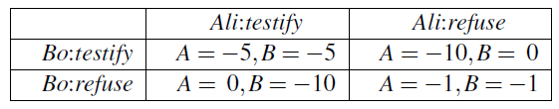
Non-Cooperative Game Theory
Games with a single move: Normal form games
The role of solution concepts in game theory is to try to make reasoning precise
A pure strategy is a deterministic policy; for a single-move game, a pure strategy is just a single action.
Mixed strategy: a randomized policy that selects actions according to a probability distribution.
A strategy profile is an assignment of a strategy to each player
Suppose Bo plays testify. Ali gets 5 years if Ali testify and 10 years if Ali don’t, so in that case testifying is better.

Slide 10
Non-Cooperative Game Theory
Suppose Bo plays testify. Ali gets 5 years if Ali testify and 10 years if Ali don’t, so in that case testifying is better.
On the other hand, if Bo plays refuse, then Ali go free if Ali testify and Ali get 1 year if Ali refuse, so testifying is also better in that case.
So no matter what Bo chooses to do, it would be better for Ali to testify.
Ali has discovered that testify is a dominant strategy for the game

Slide 11
Non-Cooperative Game Theory
s for player p strongly dominates strategy s if the outcome for s is better for p than the outcome for s , for every choice of strategies by the other player(s).
Strategy s weakly dominates s if s is better than s on at least one strategy profile and no worse on any other. A dominant strategy is a strategy that dominates all others.
Rational player will always choose a dominant strategy and avoid a dominated strategy.
Where all players choose a dominant strategy, then the outcome that results is said to be a dominant strategy equilibrium

Slide 12
Social Welfare
Want to choose the best overall outcome—the outcome that would be best for society as a whole
avoid outcomes that waste utility
Pareto optimality: there is no other outcome that would make one player better off without making someone else worse off
Utilitarian social welfare is a measure of how good an outcome is in the aggregate
Egalitarian social welfare: maximize expected utility of the worst-off member of society
Gini coefficient, which summarizes how evenly utility is spread among the players.

Slide 13
Social Welfare
Computing equilibria
Myopic best response or iterated best response
start by choosing a strategy profile at random; then,
if some player is not playing their optimal choice given the choices of others, flip their choice to an optimal one, and repeat the process
The process will converge if it leads to a strategy profile in which every player is making an optimal choice, given the choices of the others—a Nash equilibrium
zero-sum games—games in which the payoffs always add up to zero
Maximin technique
Minimax algorithm
once the first player has revealed a strategy, the second player might as well choose a pure strategy

Slide 14
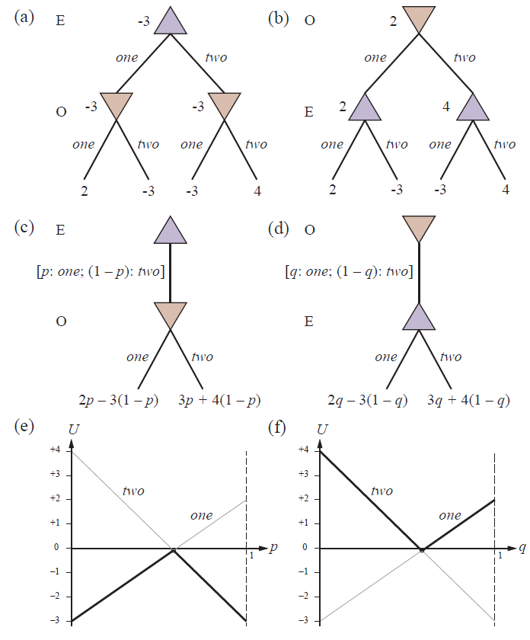
Social Welfare
(a) and (b): Minimax game trees for two-finger Morra if the players take turns playing pure strategies. (c) and (d): Parameterized game trees where the first player plays a mixed strategy. The payoffs depend on the probability parameter (p or q) in the mixed strategy. (e) and (f): For any particular value of the probability parameter, the second player will choose the “better” of the two actions, so the value of the first player’s mixed strategy is given by the heavy lines. The first player will choose the probability parameter for the mixed strategy at the intersection point.

Slide 15
Repeated games
Multiple move game – iterated game
Players repeatedly play rounds of a single-move game, called the stage game
Need a finite model of strategies for games that will be played an infinite number of rounds
Finite state machines (FSMs)
Tit-for-Tat strategy
simply copy whatever its counterpart did on the previous round.
HAWK and DOVE strategies are simpler
Chooses dominant all the time
GRIM strategy is somewhat similar to TIT-FOR-TAT, but with one important difference: if ever its counterpart plays its dominant action, then it essentially turns into HAWK

Slide 16
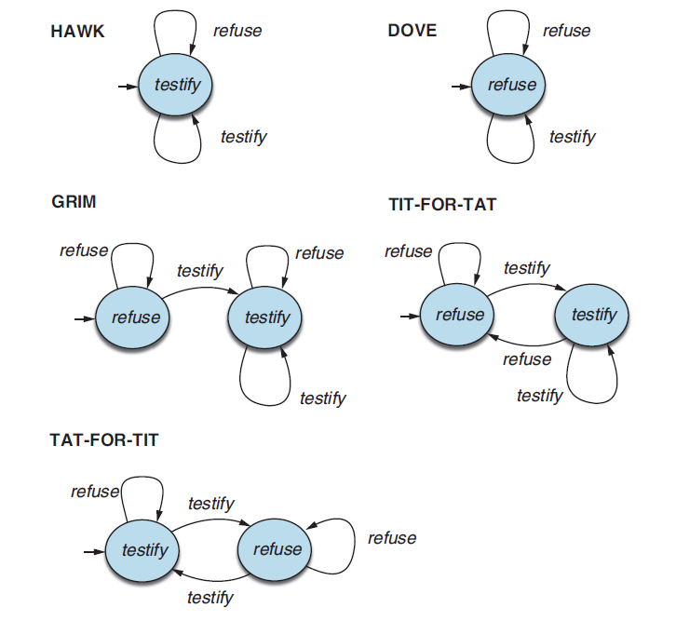
Repeated games
Some common, colorfully named finite-state machine strategies for the infinitely repeated prisoner’s dilemma

Slide 17
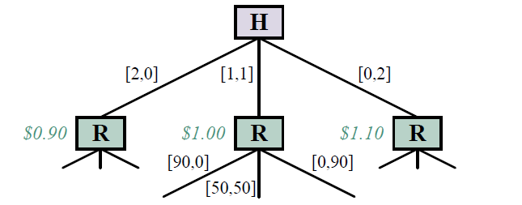
Repeated games
Assistance games example: paperclip game
The paperclip game. Each branch is labeled [p; s] denoting the number of paperclips and staples manufactured on that branch. Harriet the human can choose to make two paperclips, two staples, or one of each. (The values in green italics are the values for Harriet if the game ended there, assuming =0:45.) Robbie the robot then has a choice to make 90
paperclips, 90 staples, or 50 of each.

Slide 18
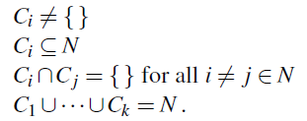
Cooperative Game Theory
G = (N, ν) to say that a cooperative game, G, is defined set of players N = {1,…,n} and a characteristic function, v, every subset of players value the group of players could obtain.
Coalition: subset of players C.
The set of all players N is known as the grand coalition.
Choice of joining one coalition creates partitions.
players N is a set of coalitions {C₁, . . . ,C_{k}}
For example, if we have N = {1, 2, 3}, then there are seven possible coalitions:
{1}, {2}, {3}, {1, 2}, {2, 3}, {3, 1}, and {1, 2, 3}
and five possible coalition structures:
{{1},{2},{3}}, {{1},{2, 3}}, {{2},{1, 3}}, {{3},{1, 2}}, and {{1, 2, 3}}.

Slide 19


Cooperative Game Theory
The payoff must satisfy the constraint that each coalition C splits up all
of its value ν(C) among its members:
Superadditivity: Some cooperative games have two coalitions merge together
ν(C ∪ D) ≥ ν(C) + ν(D) for all C, D ⊆ N
An imputation for a cooperative game (N, v) is a payoff vector that satisfies
Shapley value: fair distributions scheme
divide the ν(N) value among the players, given that the grand coalition N formed
Divided according to contribution creating the value v(N).

Slide 20

Cooperative Game Theory
Marginal contribution that player i makes to C is denoted by mc_{i}(C):
Fairness axioms satisfied by the Shapley value
Efficiency
Dummy player
Symmetry
Additivity

Slide 21
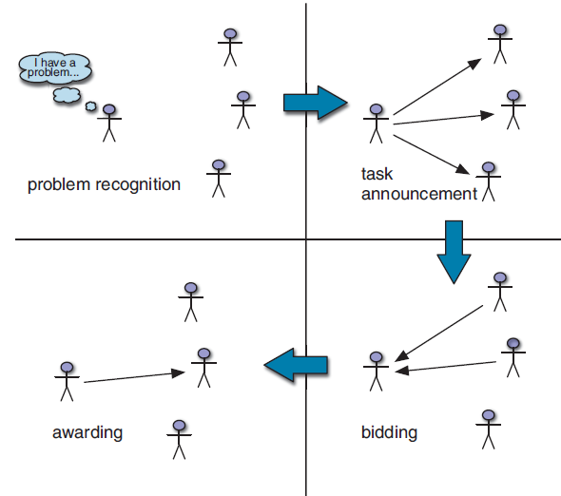
Making Collective Decisions
Mechanism: language, distinguished agent, outcome rule
Allocating tasks with the contract net has four phases
The contract net task allocation protocol.

Slide 22
Making Collective Decisions
Allocating scarce resources with auctions
Ascending-bid auction or English auction
asking for a minimum (or reserve) bid b_{min} .
b_{min} + d, for some increment d,
auction ends when nobody is willing to bid, last bidder wins
Dominant strategy
Sealed-bid auction
Each bidder makes a single bid and communicates it to the auctioneer, without the other bidders seeing it.
Sealed-bid second-price
Winner pays second highest bid rather than own.

Slide 23
Making Collective Decisions
Voting
social choice theory
Using a social welfare function, to come up with a social preference order: a ranking of the candidates, from most preferred down to least preferred.
4 properties of good social welfare function to satisfy
The Pareto Condition
The Condorcet Winner Condition
Independence of Irrelevant Alternatives (IIA)
No Dictatorships
Arrow’s theorem says impossible to satisfy all four conditions

Slide 24

Making Collective Decisions
The Zeuthen strategy
measure an agent’s willingness to risk conflict.
Intuitively, an agent will be more willing to risk conflict if the difference in utility between its current proposal and the conflict deal is low
Higher risk value indicate that i has less to lose from conflict, and so is more
willing to risk conflict.

Slide 25
Summary
Multiagent planning is necessary when there are other agents in the environment with which to cooperate or compete.
Game theory describes rational behavior for agents in situations in which multiple
agents interact.
Solution concepts in game theory are intended to characterize rational outcomes of a game
Non-cooperative game theory assumes that agents must make their decisions independently
Cooperative game theory considers settings in which agents can make binding agreements to form coalitions in order to cooperate.

